Slide 1
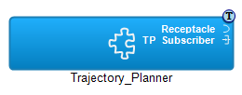
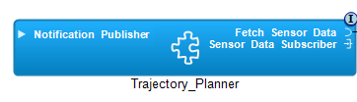
// Operation: on_one_data
// Port : Sensor_Data_Subscriber
// Priority : 60; Deadline : 50 ms
Do on_one_data [60, 50] {
12;
RMI Fetch_Sensor_Data.fetch_data;
16;
DDS_Publish Notification_Publisher.Plan;
}
// Operation: on_one_data
// Priority: 60; Deadline: 50 ms
Do on_one_data [60, 50] {
12
RMI Fetch_Sensor_Data.fetch_data [4, 4];
16
DDS_Publish Notification_Publisher.Plan [1]
}

Slide 2
{opname="on_one_data", op_node="Sat1", op_comp="Trajectory_Planner",
op_pn=“Partition1", op_prio=60, op_dl=50,
op_steps=[{port_type="Local", port_name="Local",
unblk_list=[], call_exec_t=0, call_dur=12},
{port_type="RMI_Receptacle", port_name="Fetch_Sensor_Data",
unblk_list=[], call_exec_t=0, call_dur=0},
{port_type="Local", port_name="Local",
unblk_list=[], call_exec_t=0, call_dur=16},
{port_type=“Publisher”, port_name=“Notification_Publisher”,
unblk_list=[], call_exec_t=0, call_dur=0]}}

Slide 3

GPS
Image
Processing

Slide 4
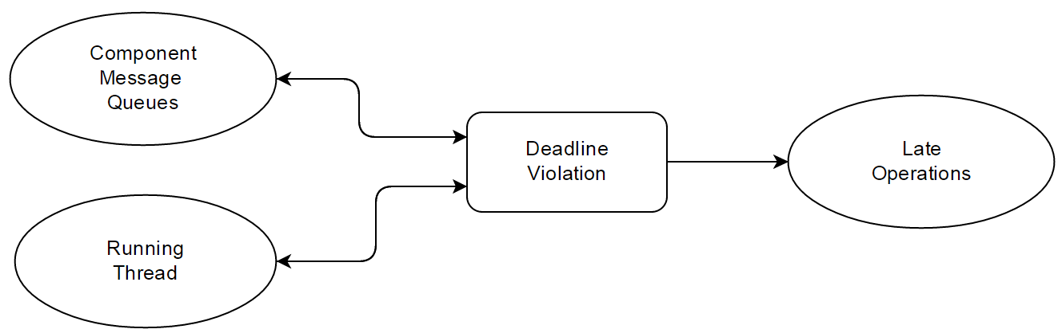
DL_guard

Slide 5
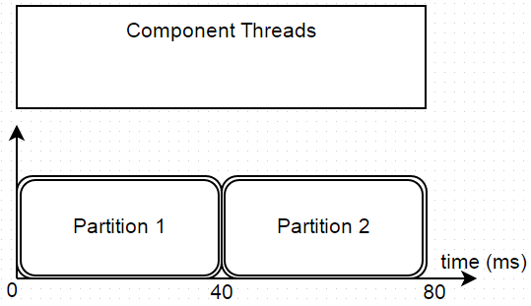
th1
th1
th2
th3
th4
th5
th6

Slide 6

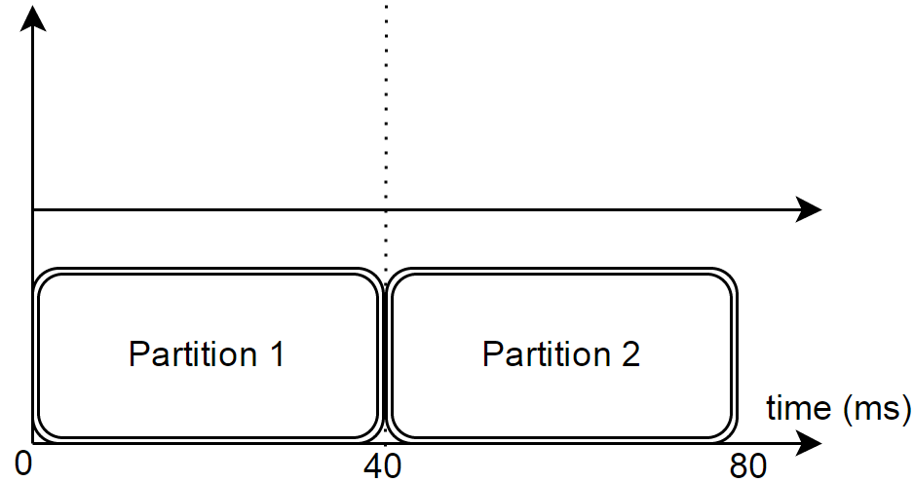
th3
th1
th2
th5
th6
th4
8
48

Slide 7


Thrusters
Satellite 2
Flight
Control
GPS
DREMS
Application
Remote
Sensing
Ground
COM
Satellite 3
cam
I/O
DREMS
Application
DREMS OS
Command
Proxy
Satellite 1 – Cluster Leader
Ground Station

Slide 8
scatter operation
Satellite 1 – Flight Control
GPS
Command Proxy
Fetch_GPS
Calculate
Trajectory
10 ms
Control
Thrusters
6 ms

Slide 9
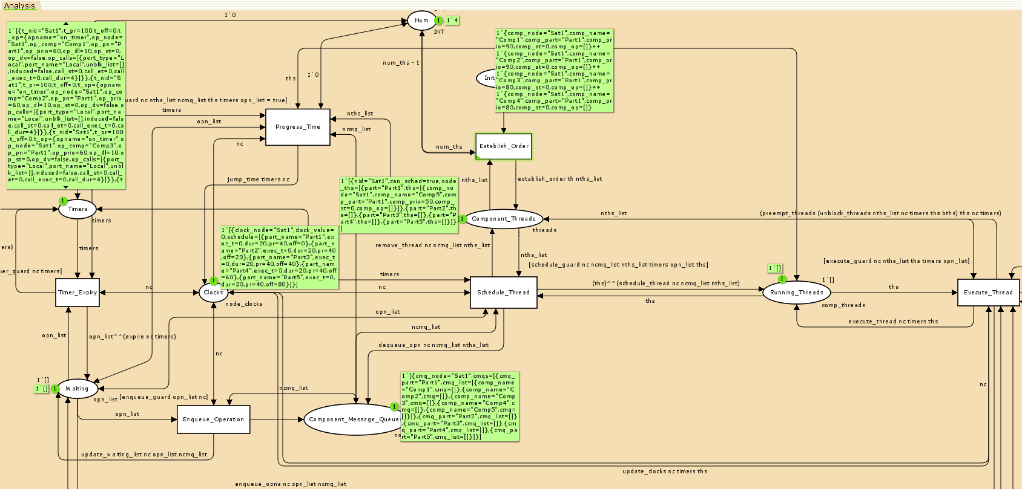
This is a sample CPN analysis model generated from a domain-specific design model. The model includes colored tokens representing various aspects of the system such as component timers, threading properties and message queues. These tokens are operated on by transitions and arc functions that dictate and represent the overall behavior of the system once deployed.

